Slide 1
District 90 Literacy Committee Curriculum Review Process - Pilot Selection
Board of Education Meeting
Monday, April 15, 2024

Slide 2
Presentation Overview
K-8 materials vetting sub-committee members
Review of materials vetting process
Results of quantitative review
Classroom pilot: selected instructional materials
Estimated pilot cost
Spring foundational skills pilot calendar
Next Steps

Slide 3
Materials Vetting Sub-Committee (K-5)
Committee Member | Grade Level/Responsibility | School
Barb Garvey | Kindergarten | Willard
Diana Neilson | Grade 1 | Lincoln
Ginger Timchak | Grade 1 | Lincoln
Lili Becerril | Grade 2 | Willard
Lauren Baiocchi | Grade 3 | Lincoln
Andrea Costin | Grade 3 | Willard
Alison McKenna | Grade 3 | Lincoln
Kate Szostak | Grade 3 | Willard
Gail Barrett | Grade 5 | Roosevelt
Jerri Gapastione | Grade 5 | Roosevelt
Amy Betman | Grade 5 | Roosevelt
Dana Gunderson | Special Education | Roosevelt
Margaret Jesse | Reading Specialist | Roosevelt
Cynthia Mares | Reading Specialist | Lincoln
Kathy Strachowski | Reading Specialist | Willard
Kathleen Fleming | Instructional Specialist | Willard
Joy O'Reilly | Instructional Specialist | Lincoln
Christine Gerges | Assistant Principal | Lincoln and Willard

Slide 4
Materials Vetting Sub-Committee (6-8)
Committee Member | Grade Level/Responsibility | School
Melissa Graves | Grade 6 | Roosevelt
Beth Micucci | Grade 6 | Roosevelt
Rachel Parker | Grade 6 | Roosevelt
Lana Momani | Grade 7 | Roosevelt
Patty Feierberg | Grade 7 | Roosevelt
Julie Daly | Grade 8 | Roosevelt
Colleen Pariso | Grade 8 | Roosevelt
Louisa Starr | Grade 7 & 8 | Roosevelt
Cheryl Allaire | Grade 5-8 | Roosevelt
Anna Daly | Special Education | Roosevelt
Eileen Lewis | Special Education | Roosevelt
Kristin McCormick | Special Education | Roosevelt
Michael Schlachter | Reading Specialist | Roosevelt
Julie Fleisch | Literacy Coach | Roosevelt
Tina Steketee | Assistant Principal | Roosevelt

Slide 5
Review of Materials Vetting Process
Vetting sub-committee meetings were conducted in grade-level bands K-2; 3-5; 6-8
Teams utilized the Ed Reports scoring scale
Criteria is present = 3
Criteria is partially present = 1
Criteria is not present = 0
Instructional materials were rated individually by each grade level
Final score for each program is the average of the individual grade level ratings

Slide 6
K-3 Foundational Skills Criteria
Print concepts and letter recognition (K-1 only)
Phonological awareness
Phonics and word recognition
Fluency
Handwriting

Slide 7
Foundational Skills Program Vetting Results Grades K-2
Foundational Skills Programs | Kindergarten | Grade 1 | Grade 2 | Composite Score
Heggerty | 2.84 | 3 | 3 | 2.94
Fundations | 2.6 | 2.92 | 2.53 | 2.68
Into Reading | 0.89 | 2.47 | 3 | 2.12
Phonics to Reading | 1.36 | 2.63 | 1.4 | 1.78
Being a Reader | 0.96 | 1.57 | 1.91 | 1.48
University of Florida Reading Institute (UFLI) | 0.83 | 0.81 | 2.6 | 1.41
Scoring:​
Criteria is present = 3​
Criteria is partially present = 1​
Criteria is not present = 0

Slide 8
Core Instructional Program Vetting Results Grades K-2
Comprehensive Programs | Kindergarten | Grade 1 | Grade 2 | Composite Score
Into Reading | 1.31 | 2.54 | 3.00 | 2.28
Being a Reader | 1.64 | 2.10 | 2.45 | 2.06
American Reading Company | 0.75 | 2.60 | 1.42 | 1.59
My View | 1.58 | 1.55 | 0.66 | 1.26
Wit & Wisdom | 0.45 | 0.15 | 2.60 | 1.06
EL Education | 0.70 | 0.58 | 1.51 | 0.93
Wonders | 0.70 | 1.13 | 0.80 | 0.88
CKLA | 0.35 | 0.42 | 0.45 | 0.41
Scoring:
Criteria is present = 3
Criteria is partially present = 1
Criteria is not present = 0

Slide 9
Core Instructional Materials Vetting Results Grades 3-5
Comprehensive Programs | Grade 3 | Grade 4 | Grade 5 | Composite Score
Being a Reader | 3 | 2.24 | 2.64 | 2.62
Into Reading | 2.79 | 2.35 | 2.23 | 2.45
American Reading Company | 2.13 | 2.00 | 0.94 | 1.69
EL Education | 1.21 | 0.75 | 2.41 | 1.45
Wonders | 1.86 | 0.86 | 0.65 | 1.12
Wit & Wisdom | 1.28 | 0.85 | 1 | 1.04
My Perspectives | 1.86 | 0.86 | 0.76 | 1.16
CKLA | 0.68 | 0.27 | 0.94 | 0.63
Scoring:​
Criteria is present = 3​
Criteria is partially present = 1​
Criteria is not present = 0

Slide 10
Core Instructional Materials Vetting Results Grades 6-8
Comprehensive Programs | Grade 6 | Grade 7 | Grade 8 | Composite Score
EL Education | 2.57 | 2.42 | 2.35 | 2.44
Wit & Wisdom | 2.21 | 2.64 | 0.86 | 1.90
My Perspectives | 1.29 | 2.00 | 2.29 | 1.86
American Reading Company | 1.86 | 1.64 | 1.43 | 1.64
StudySync | 1.57 | 1.64 | 1.71 | 1.64
CommonLit | 0.71 | 2.14 | 1.79 | 1.54
Into Literature | 1.00 | 1.36 | 0.86 | 1.07
CKLA (Amplify) | 1.36 | 1.07 | 0.71 | 1.05
Scoring:​
Criteria is present = 3​
Criteria is partially present = 1​
Criteria is not present = 0

Slide 11
Classroom Pilot: Selected Instructional Materials
Program | Publisher | Financial Partner
Fundations Foundational Skills (K-3) | Wilson Language Training Corporation | Alpine Investors
Bridge to Reading Foundational Skills (K-3) | Heggerty | L Squared Capital Partners, Longview Asset Management, existing Heggerty shareholders
Into Reading (K-5) | Houghton Mifflin Harcourt (HMH) | Veritas Capital
Being a Reader (K-5) Being a Writer (K-5) | Collaborative Classroom | Non-Profit Organization
Wit and Wisdom (6-8) | Great Minds | State departments and federal agencies
EL Education (6-8) (open source) | Imagine Learning (provides digital component) | Weld North LLC

Slide 12
Estimated Instructional Materials Cost – Pilot Stage
Instructional Program | Cost to D90 | Materials Purchased | Materials Provided by Vendor | Training
Heggerty: Bridge to Reading (K-2) | $8208.00 | Instructional videos and online resources | K-2 classroom kits | Provided by D90 Instructional Specialists
Fundations (K-3) | $3337.50 | Sound cards Magnetic strips Vowel posters Flashcards Student notebooks | Online Teacher Editions Online resources | Provided by D90 Instructional Specialists
Being a Reader (K-5) Being a Writer (K-5) | TBD | TBD | D90 may draft a Memorandum of Understanding for vendor supplied classroom kits/resources at no cost to be returned if materials are not adopted | 8 one- hour virtual professional learning sessions One day in-school consultation pilot support $7200

Slide 13
Estimated Instructional Materials Cost – Pilot Stage
Instructional Program | Cost to D90 | Materials Purchased | Materials Provided by Vendor | Training
Into Reading (K-5) | $4264.88 | K-5 Into Reading Student myBook | Online materials Teacher Editions | Provided by vendor at no cost
Great Minds (6-8) | $3749.44 (35% discount) | Grade 6 unit module student resources Grade 7 unit module student resources | Teacher editions Student editions Online resources | Provided by vendor at no cost
EL Education (6-8) | $7561.66 | Student resource notebooks Teacher lessons module kits Student module lessons Trade books | Online resources | One three-hour pilot training webinar $2500
Total estimated materials cost: $27,121.48
Total estimated training cost: $9,700.00

Slide 14
K-3 Foundational Skills Spring Pilot Timeline
Timeframe | Objectives
Week of April 1st | Pilot training #1 for Heggerty and Fundations
April 8 – 26 | Classroom pilot #1
Week of April 29th | Pilot training #2 for Heggerty and Fundations
May 6 - 24 | Classroom pilot #2
September* | Grade 3 only – Heggerty classroom pilot
*Heggerty materials for Grade 3 not available until July

Slide 15
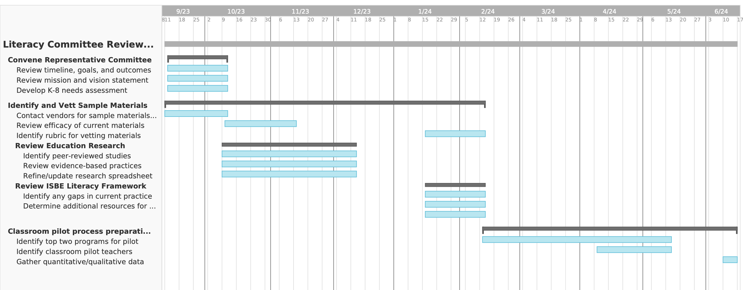
Literacy Committee Timeline

Slide 16
Instructional Materials Pilot: Next Steps
Finalize
Finalize K-8 pilot team members
Schedule
Schedule pilot training
Order
Order pilot materials
Draft
Draft fall pilot schedule for core instructional materials

Slide 17
Questions?
Thank you!

